Slide 1
Chapter 12
Enumerations, Autoboxing, Static Import,
and Annotations
李晔锋

Slide 2
Key Skills & Concepts
Understand enumeration fundamentals
Use the class-based features of enumerations
Apply the values( ) and valueof( ) methods to enumerations
Create enumerations that have constructors, instance variables, and methods
Employ the ordinal( ) and compareTo( ) methods that enumerations inherit from Enum
Use Java’s type wrappers
Know the basics of autoboxing and auto-unboxing
Use autoboxing with methods
Understand how autoboxing works with expressions
Apply static import
Gain an overview of annotations

Slide 3
Enumerations（枚举）
In its simplest form, an enumeration is a list of named constants that define a new data type. An object of an enumeration type can hold only the values that are defined by the list.

Slide 4
Enumeration Fundamentals
An enumeration is created using the enum keyword. For example, here is a simple enumeration that lists various forms of transportation:
enum Transport{
CAR, TRUCK, AIRPLANE, TRAIN, BOAT
}
The identifiers CAR, TRUCK, and so on, are called enumeration constants. Each is implicitly declared as a public, static member of Transport.

Slide 5
Enumeration Fundamentals
Once you have defined an enumeration, you can create a variable of that type. However, even though enumerations define a class type, you do not instantiate an enum using new. For example:
Transport tp;
tp = Transport.AIRPLANE;
Two enumeration constants can be compared for equality by using the = = relational operator. For example:
if(tp == Transport.TRAIN) …

Slide 6
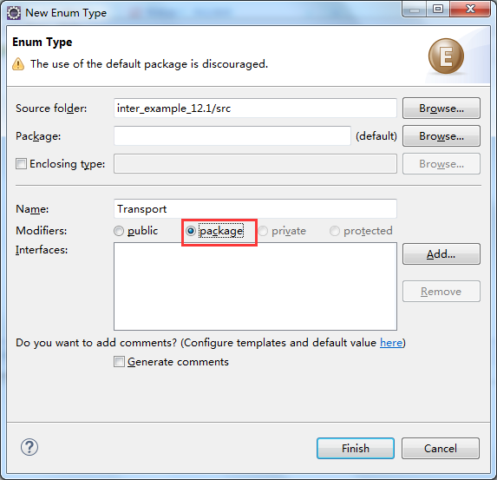
Create Enum in Eclipse
Right click on the corresponding directory, select “new”-> “Enum”.

Slide 7
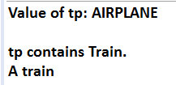
enum Transport {
CAR, TRUCK, AIRPLANE, TRAIN, BOAT
}
public class EnumDemo {
public static void main(String[] args) {
// TODO Auto-generated method stub
Transport tp;
tp = Transport.AIRPLANE;
System.out.println("Value of tp: " + tp);
System.out.println();
tp = Transport.TRAIN;
if(tp == Transport.TRAIN)
System.out.println("tp contains Train.");
switch(tp) {
case CAR: System.out.println("A car");break;
case TRUCK: System.out.println("A truck");break;
case AIRPLANE: System.out.println("An airplane");break;
case TRAIN: System.out.println("A train");break;
case BOAT: System.out.println("A boat");break;
}
}
}

Slide 8
Java Enumerations Are Class Types
When you create an enumeration via Eclipse, a java file with the same name as the enumeration is created. Similar to that of interface, enumerations are class types.

Slide 9
The values( ) and valueOf( ) Methods
All enumerations automatically have two predefined methods: values( ) and valueOf( ). Their general forms are shown here:
public static enum-type[ ] values( )
public static enum-type valueOf(String str)
The values( ) method returns an array that contains a list of the enumeration constants. The valueOf( ) method returns the enumeration constant whose value corresponds to the string passed in str.

Slide 10
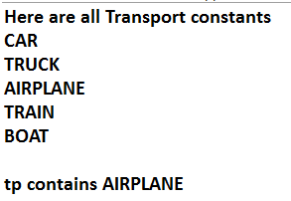
public class EnumDemo2 {
public static void main(String[] args) {
// TODO Auto-generated method stub
Transport tp;
System.out.println("Here are all Transport constants");
Transport allTransports[] = Transport.values();
for(Transport t: allTransports)
System.out.println(t);
System.out.println();
tp = Transport.valueOf("AIRPLANE");
System.out.println("tp contains " + tp);
}
}

Slide 11
Constructors, Methods, Instance Variables, and Enumerations
It is important to understand that each enumeration constant is an object of its enumeration type. Thus, an enumeration can define constructors, add methods, and have instance variables.

Slide 12
enum Transport {
CAR(65), TRUCK(55), AIRPLANE(600), TRAIN(70), BOAT(22);
private int speed;
Transport(int s){speed = s;}
public int getSpeed() {return speed;}
}
public class EnumDemo3 {
public static void main(String[] args) {
// TODO Auto-generated method stub
Transport tp = Transport.AIRPLANE;
System.out.print("Typical speed for an airplane is ");
System.out.println(tp.getSpeed() + " miles per hour.\n");
for(Transport t: Transport.values()) {
System.out.print(t + " typical speed is ");
System.out.println(t.getSpeed() + " miles per hour.");
}
}
}

Slide 13
Two Important Restrictions
There are two restrictions that apply to enumerations. First, an enumeration can’t inherit another class. Second, an enum cannot be a superclass. This means that an enum can’t be extended.

Slide 14
Enumerations Inherit Enum
Although you can’t inherit a superclass when declaring an enum, all enumerations automatically inherit one: java.lang.Enum. This class defines several methods that are available for use by all enumerations.
The ordinal( ) method obtains a value that indicates an enumeration constant’s position in the list of constants. This is called its ordinal value. The ordinal( ) method is shown here:
final int ordinal( )

Slide 15
Enumerations Inherit Enum
You can compare the ordinal value of two constants of the same enumeration by using the compareTo( ) method. It has this general form:
final int compareTo(enum-type e)

Slide 16
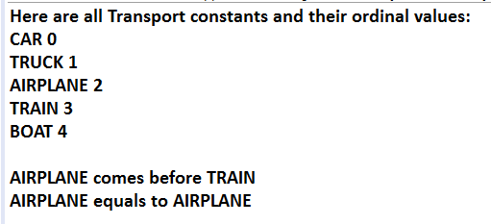
public class EnumDemo4 {
public static void main(String[] args) {
// TODO Auto-generated method stub
Transport tp,tp2,tp3;
System.out.print("Here are all Transport constants");
System.out.println(" and their ordinal values: ");
for(Transport t: Transport.values())
System.out.println(t + " " + t.ordinal());
tp = Transport.AIRPLANE;
tp2 = Transport.TRAIN;
tp3 = Transport.AIRPLANE;
System.out.println();
if(tp.compareTo(tp2) < 0)
System.out.println(tp + " comes before " + tp2);
if(tp.compareTo(tp2) > 0)
System.out.println(tp + " comes after " + tp2);
if(tp.compareTo(tp3) == 0)
System.out.println(tp + " equals to " + tp3);
}
}

Slide 17
Autoboxing（自动装箱）
Autoboxing/unboxing is directly related to Java’s type wrappers, and to the way that values are moved into and out of an instance of a wrapper.

Slide 18
Type Wrappers
The type wrappers are Double, Float, Long, Integer, Short, Byte, Character, and Boolean, which are packaged in java.lang. All of the numeric type wrappers inherit the abstract class Number. Number declares methods that return the value of an object in each of the different numeric types.
byte byteValue( )
double doubleValue( )
float floatValue( )
int intValue( )
long longValue( )
short shortValue( )

Slide 19
Type Wrappers
All of the numeric type wrappers define constructors that allow an object to be constructed from a given value, or a string representation of that value. For example, here are the constructors defined for Integer and Double:
Integer(int num)
Integer(String str) throws NumberFormatException
Double(double num)
Double(String str) throws NumberFormatException
If str does not contain a valid numeric value, then a NumberFormatException is thrown.

Slide 20
Type Wrappers
Today, it is recommended that you use one of the valueOf( ) methods to obtain a wrapper object. The valueOf( ) method is a static member of all of the wrapper classes and all numeric classes support forms that convert a numeric value or a string into an object. For example, here are two forms supported by Integer:
static Integer valueOf(int val)
static Integer valueOf(String valStr) throws NumberFormatException

Slide 21
Manually Boxing and Unboxing with Type Wrapper
public class Wrap {
public static void main(String[] args) {
// TODO Auto-generated method stub
Integer iOb = Integer.valueOf(100);
Integer iOb2 =Integer.valueOf("100");
int i = iOb.intValue();
System.out.println(i + " " + iOb + " " + iOb2);
}
}
Manually Box
Manually Unbox

Slide 22
Autoboxing Fundamentals
public class AutoBox {
public static void main(String[] args) {
// TODO Auto-generated method stub
int iOb = 100;
int i = iOb;
System.out.println(i + " " + iOb);
}
}
Auto-box
Auto-unbox

Slide 23
Autoboxing and Methods
Autoboxing/unboxing might occur when an argument is passed to a method or when a value is returned by a method.

Slide 24
public class AutoBox2 {
static void m(Integer v) {
System.out.println("m() received " + v);
}
static int m2() {
return 10;
}
static Integer m3() {
return 99;
}
public static void main(String[] args) {
// TODO Auto-generated method stub
m(199);
Integer iOb = m2();
System.out.println("Return value from m2() is " + iOb);
int i = m3();
System.out.println("Return value from m3() is " + i);
iOb = 100;
System.out.println("Square root of iOb is " + Math.sqrt(iOb));
}
}
The return value 99 is int, auto-boxing to Integer
Method m2() returns int, auto-boxing to an Integr object
Method m3() returns Integer, auto-unboxing to an int
Interger object is auto-unboxed when calling sqrt.

Slide 25
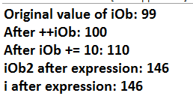
Autoboxing/Unboxing Occurs in Expressions
public class AutoBox3 {
public static void main(String[] args) {
// TODO Auto-generated method stub
Integer iOb, iOb2;
int i;
iOb = 99;
System.out.println("Original value of iOb: " + iOb);
++iOb;
System.out.println("After ++iOb: " + iOb);
iOb += 10;
System.out.println("After iOb += 10: " + iOb);
iOb2 = iOb + (iOb / 3);
System.out.println("iOb2 after expression: " + iOb2);
i = iOb + (iOb / 3);
System.out.println("i after expression: " + i);
}
}

Slide 26
Static Import
Java supports an expanded use of the import keyword. By following import with the keyword static, an import statement can be used to import the static members of a class or interface. This is called static import. When using static import, it is possible to refer to static members directly by their names, without having to qualify them with the name of their class. This simplifies and shortens the syntax required to use a static member.

Slide 27
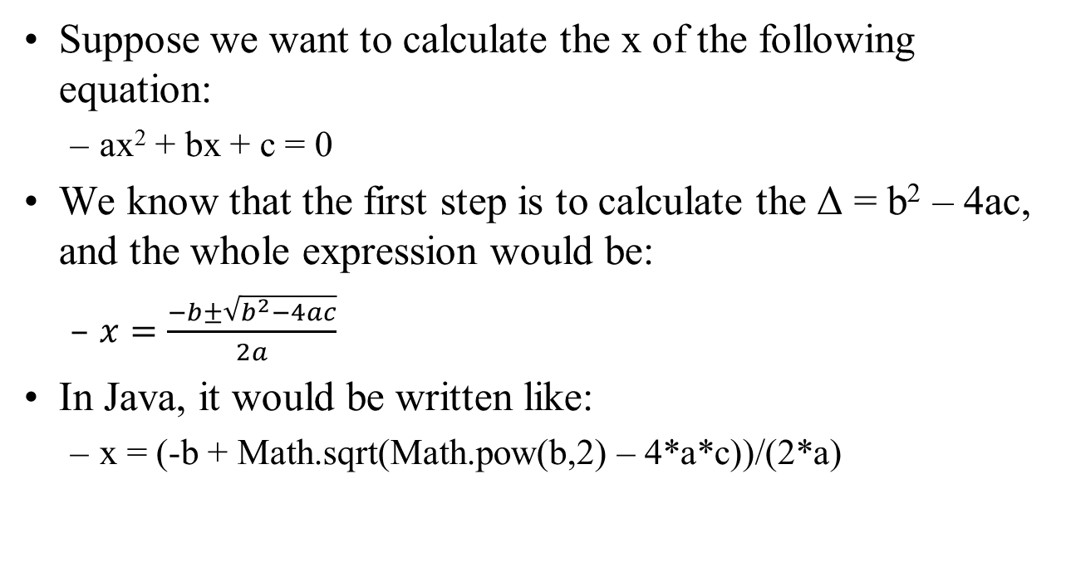
Before Using Static Import…
Suppose we want to calculate the x of the following equation:
ax² + bx + c = 0
We know that the first step is to calculate the Δ = b² – 4ac, and the whole expression would be:
$x=\frac{−b±\sqrt{b^{2}−4ac}}{2a}$
In Java, it would be written like:
x = (-b + Math.sqrt(Math.pow(b,2) – 4*a*c))/(2*a)

Slide 28
import static java.lang.Math.sqrt;
import static java.lang.Math.pow;
public class Quadratic {
public static void main(String[] args) {
// TODO Auto-generated method stub
double a,b,c,x;
a = 4; b = 1; c = -3;
x = (-b + sqrt(pow(b,2)-4*a*c)) / (2*a);
System.out.println("First solution: " + x);
x = (-b - sqrt(pow(b,2)-4*a*c)) / (2*a);
System.out.println("Second solution: " + x);
}
}

Slide 29
Annotations (Metadata)
Java provides a feature that enables you to embed supplemental information into a source file. This information, called an annotation（注解）, does not change the actions of a program.
The annotation is proceeded with the symbol “@”.

Slide 30
Create Annotation Using Eclipse
Similar to those of classes, interfaces, enumerations, the annotations can also be created by right clicking the corresponding directory, and select “new” → “Annotation”.

Slide 31
A Sample Definition of Annotation
public @interface Login {
String username() default "admin";
String password() default "123456";
}
The definition of an annotation is started with the keyword “@interface”, and the annotation name. In the body, you can define methods. However, the “methods” are actually fields indeed, thus you can add default values for them.

Slide 32
Usage of an Annotation
After definition, you can put the annotation in front of a method.
public class Connection {
@Login(username="zhangsan",password="aaa")
public void login() {
//Add your code here
}
}

Slide 33
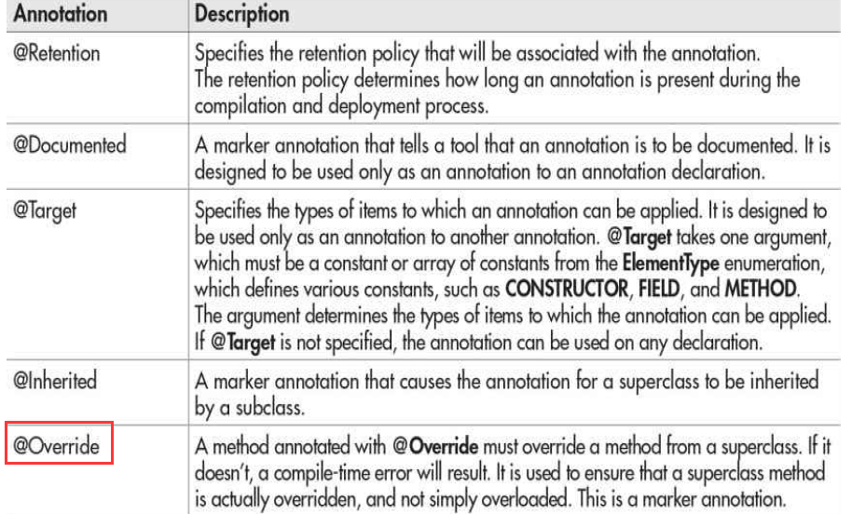
Java’s Built-in Annotations

Slide 34
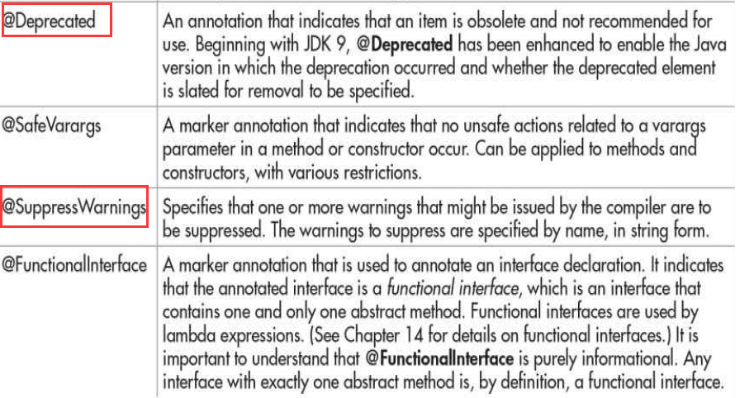
Java’s Built-in Annotations

Slide 35
@SuppressWarnings(value = "unused")
public class Sample {
private String msg;
public Sample(String msg) {
this.msg = msg;
}
@Deprecated
public String getMsg() {
return msg;
}
public void print() {
int i = 1, j = 2, k = 3;
System.out.println(i + j);
}
}
public class AnnoDemo {
public static void main(String[] args) {
// TODO Auto-generated method stub
Sample sa = new Sample("hello");
System.out.println(sa.getMsg());
}
}

